Slide 1
TCS HACKATHON
BEST OF THE BEST
Manoj, Venkat, Atchara, Suresh, Gautham

Slide 2
TCS Hackathon- Product Features
Product Key USP: Customizable accounts page, easy access to information in one or two clicks
Recent activities that can be repeated
Quick action buttons
Profile page with edit option for contact numbers, address
Favorites page for performing frequently used activities

Slide 3
Details
TCS Hackathon – Product Details
Team Members: Manoj, Venkat, Atchara, Suresh, Gautham
Type of product: Clickable Prototype
Tech Stack Used: React Native
Source code location: https://github.com/k-manojkumar/hackathon-app-rn

Slide 4
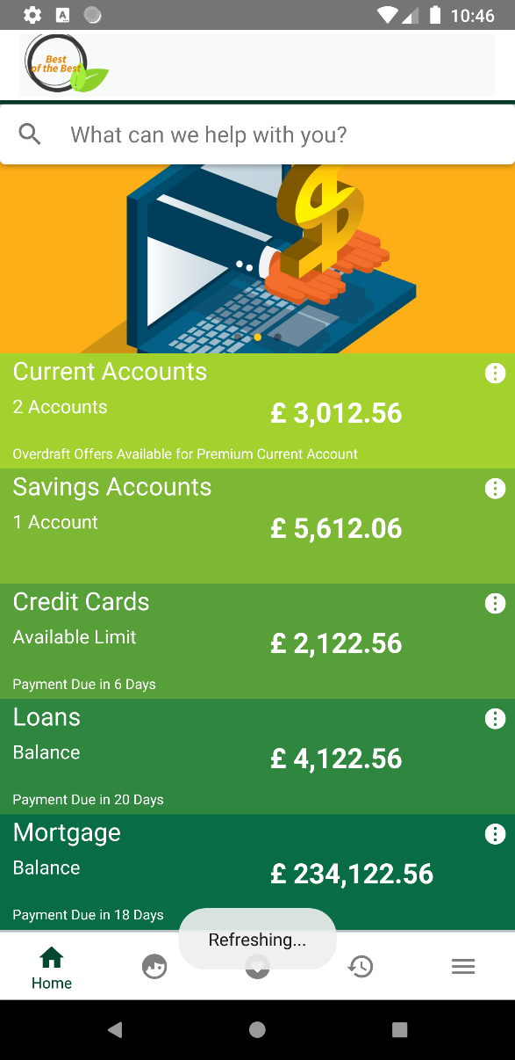
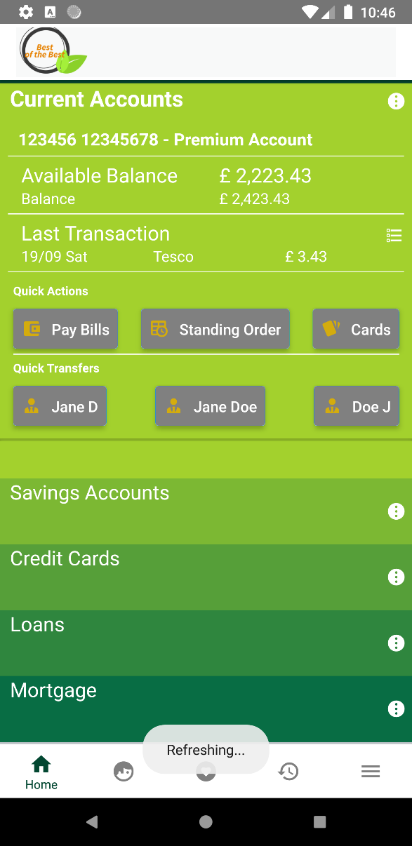
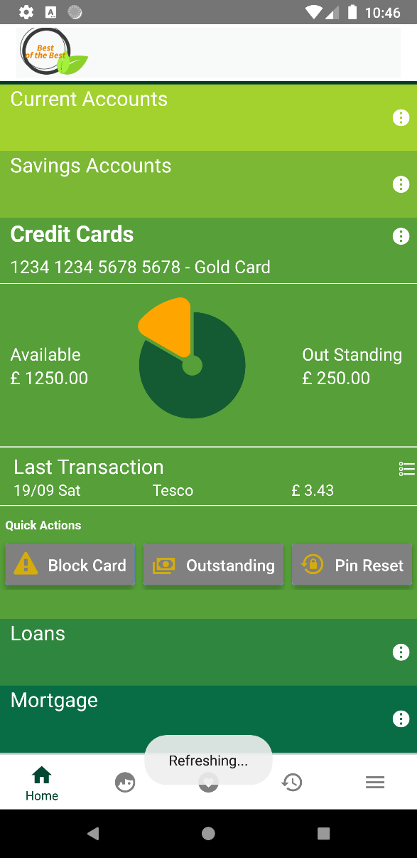
TCS Hackathon – Product Screens
1
2
3

Slide 5
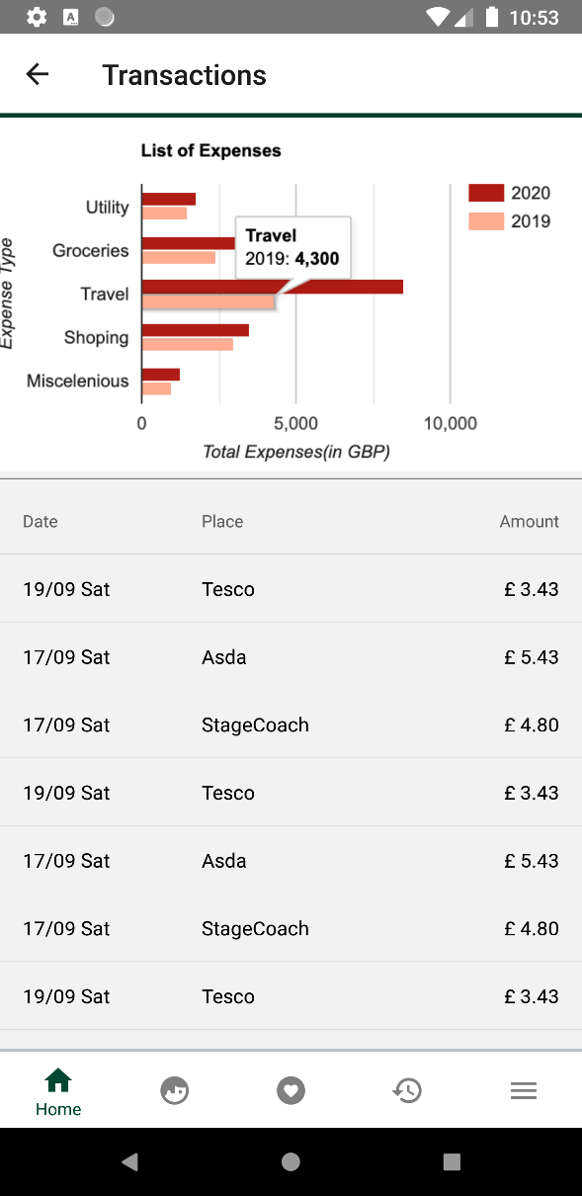
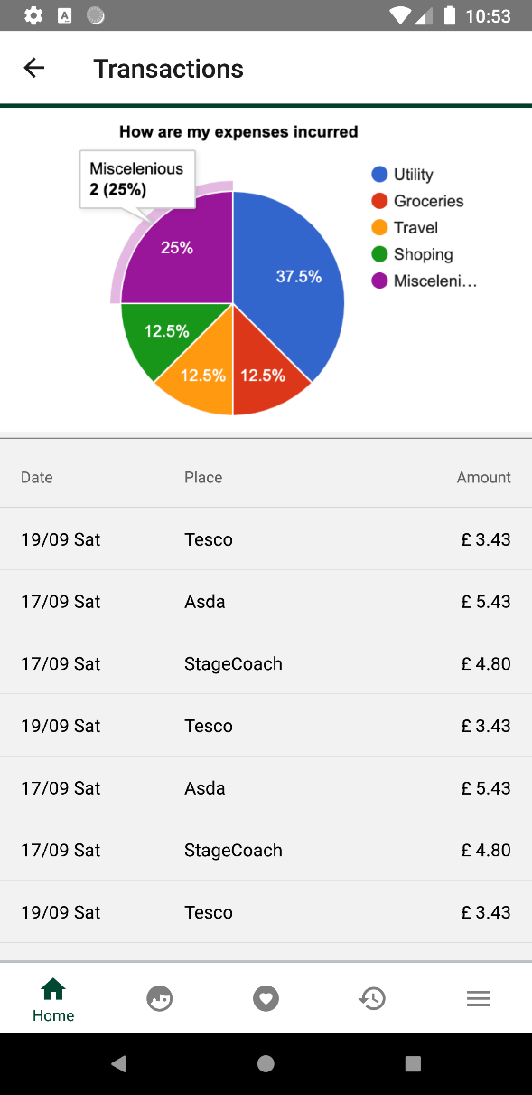
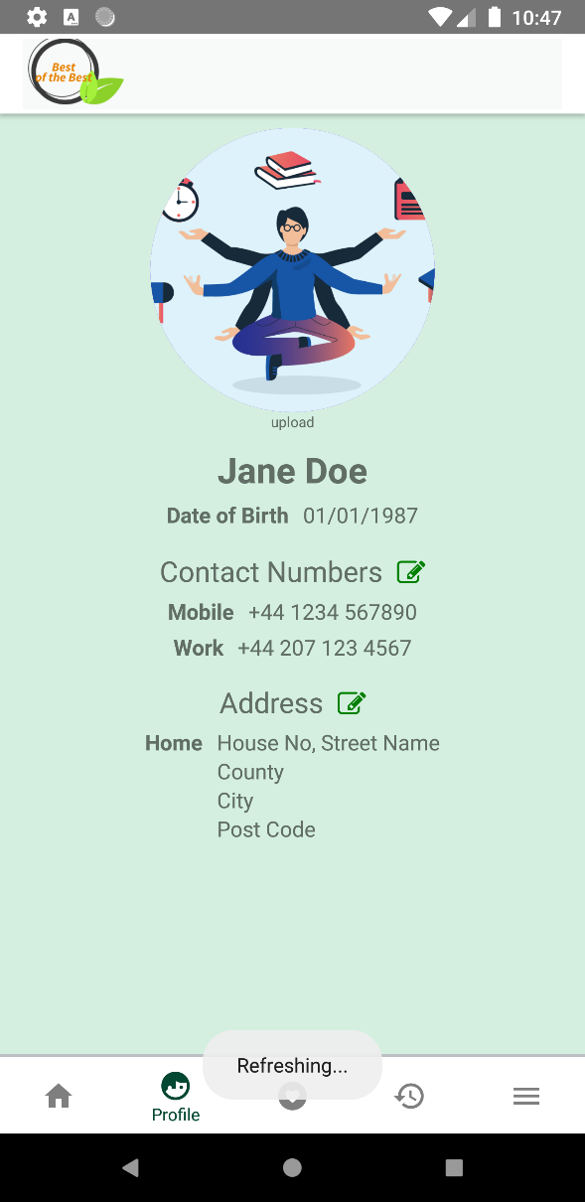
TCS Hackathon – Product Screens
4
5
6

Slide 6
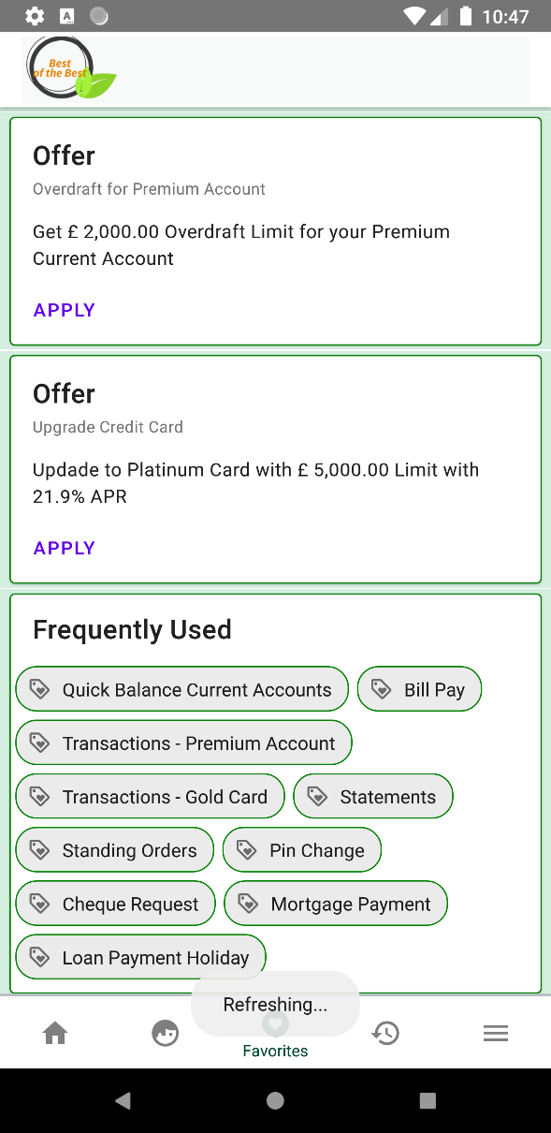
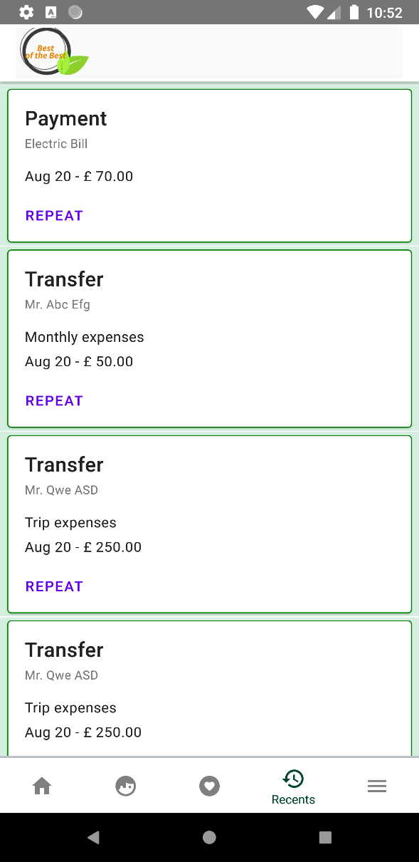
TCS Hackathon – Product Screens
7
8

Slide 7
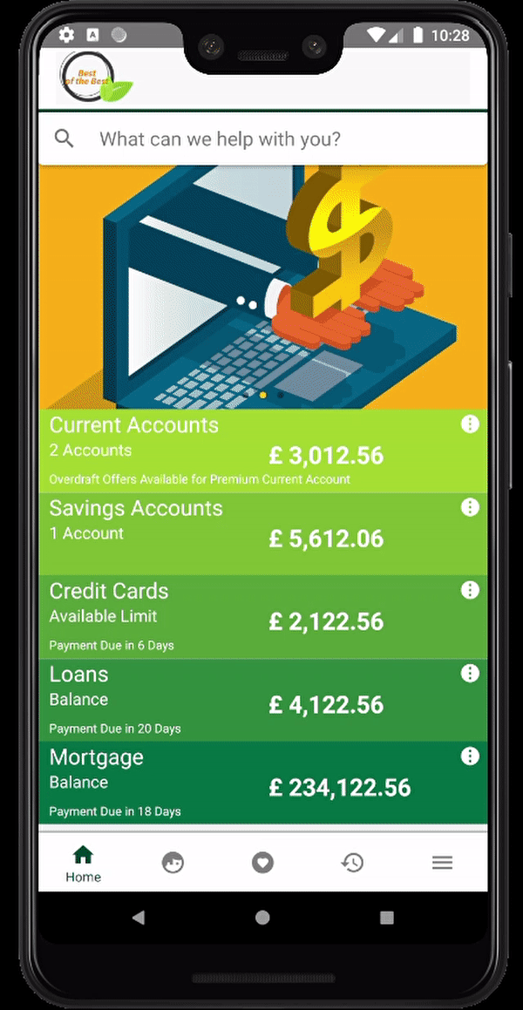
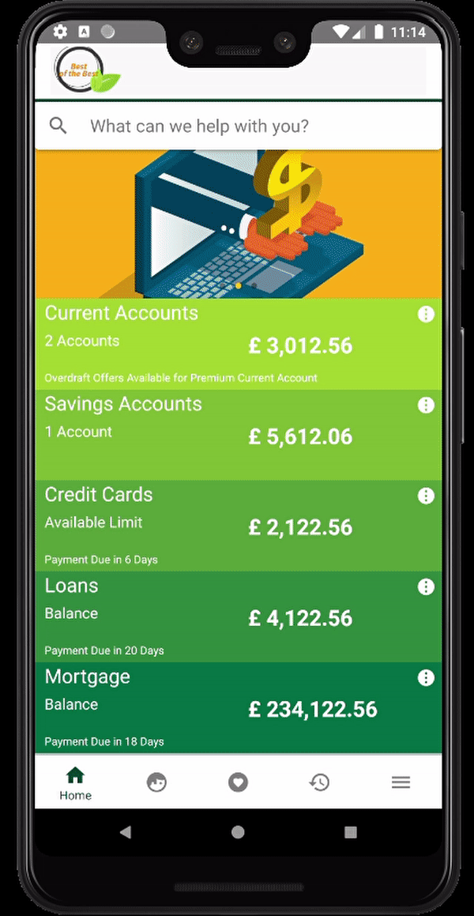
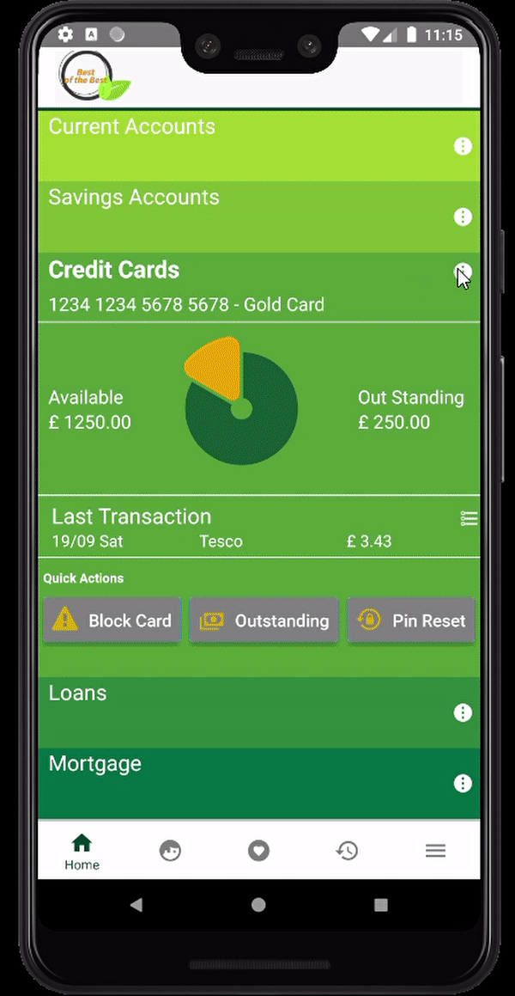
TCS Hackathon – Screen Flows
1
2
3

Slide 8
THANK YOU

